Slide 1


Slide 2
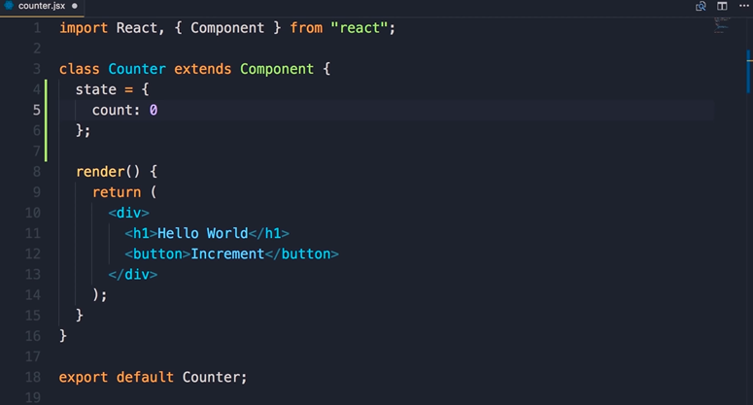

Slide 3
instead of hard-coding this hello world if you want to display a value dynamically so here in the counter class we need to add a property call it state and set it to an object
state is a special property in react component and basically it's an object that includes any data that this component needs
so in this case let's add a property in this object call it count and set it to zero

Slide 4
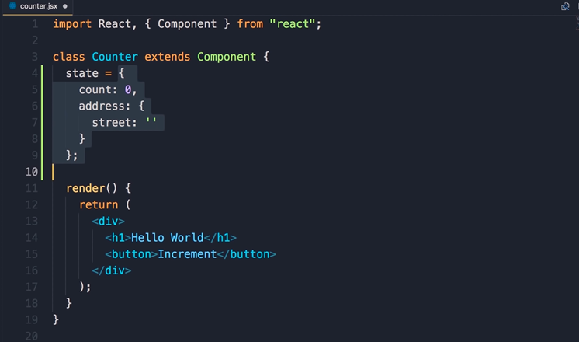

Slide 5
now here we could have a complex obj for example we could have an address that could have a street property like this so basically this state object includes any data that this component needs

Slide 6
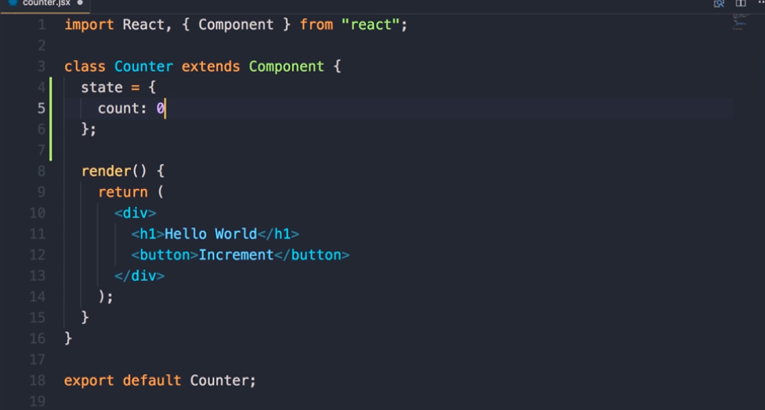

Slide 7
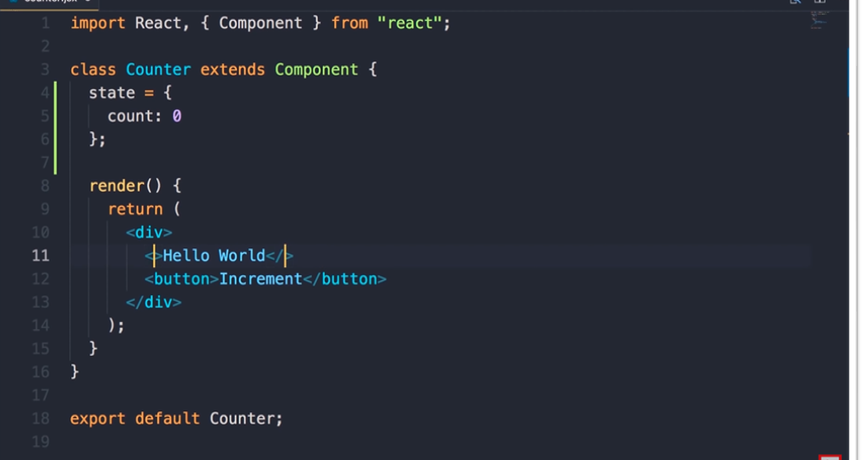

Slide 8
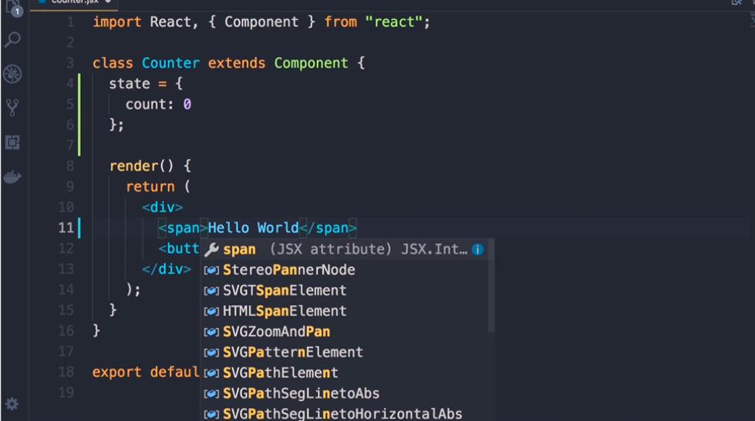

Slide 9
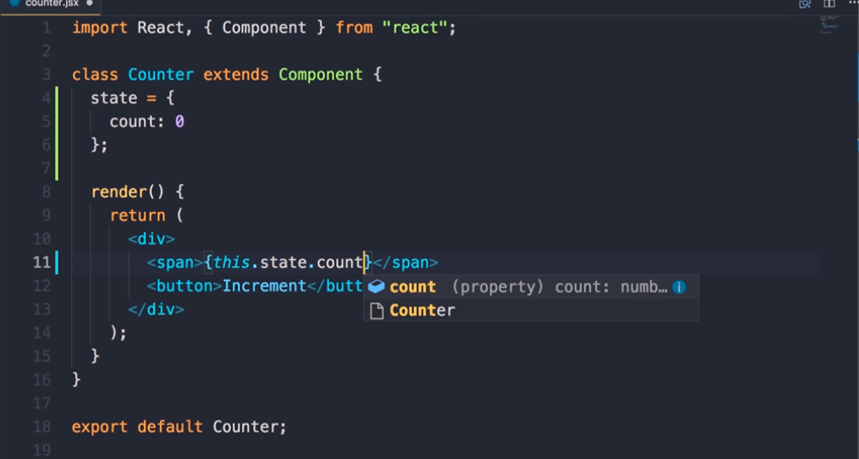

Slide 10
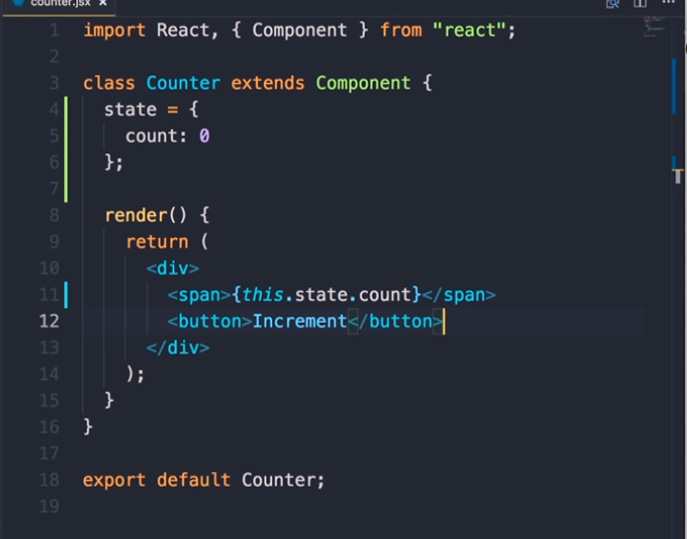

Slide 11
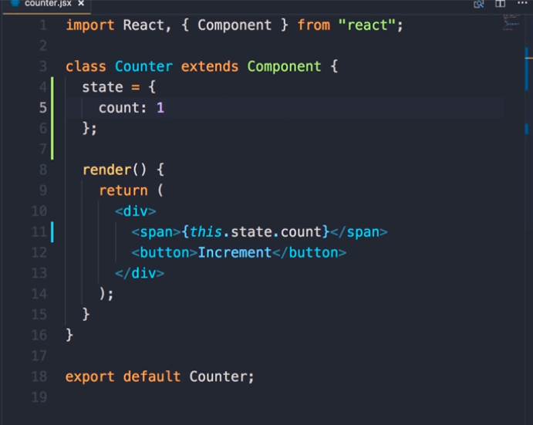

Slide 12
in this example all we need is a count property so let's simplify this
now I'm gonna replace h1 with a span
so I've selected h1 and I'm pressing command + D or ctrl + d now we have multiple cursors let's change both instances to span done
now let's remove hello world here we want to render something dynamically to do that we add curly braces and in between these curly braces we can add any valid JavaScript expressions
So if you want to render the value of the count property here we would write code like this this to reference the current object.state.count
now save the changes you can see the result here so this is our count if I change this to 1 save the changes now we see one here beautiful

Slide 13
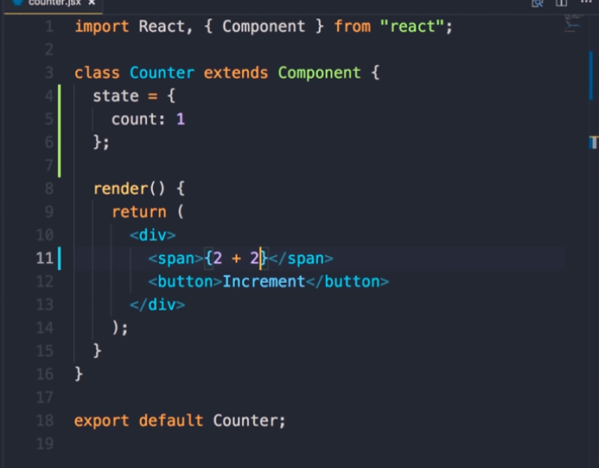

Slide 14
in between these curly braces we can write any valid JavaScript expressions an expression is something that produces a value
for example we can write something like 2 + 2 save the changes we get 4 here
or
we can call a function that returns a value

Slide 15
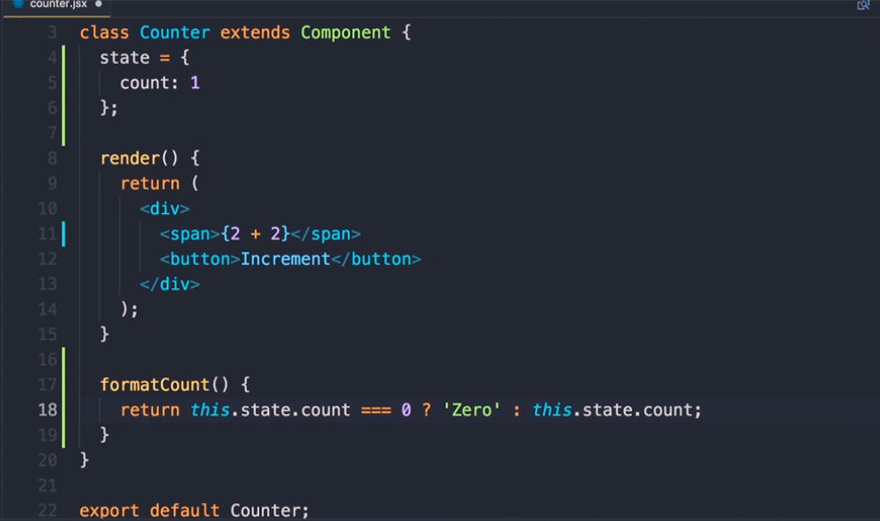

Slide 16
for example let's add a method in this class call it formaCount in this method you want to check the value of the count property if it's zero we want to return zero as a string otherwise you want to return the value of the count property

Slide 17
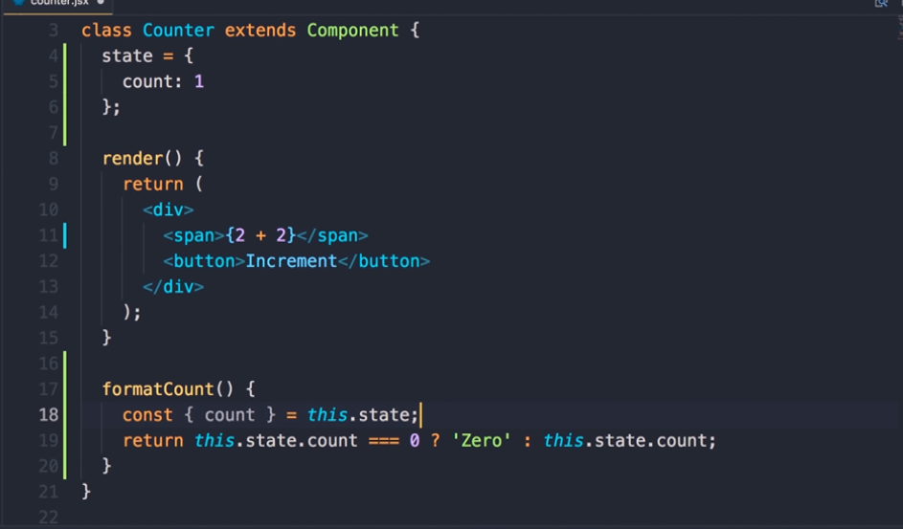

Slide 18
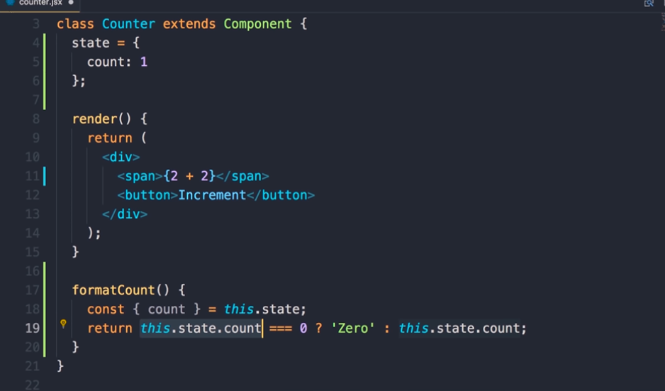

Slide 19
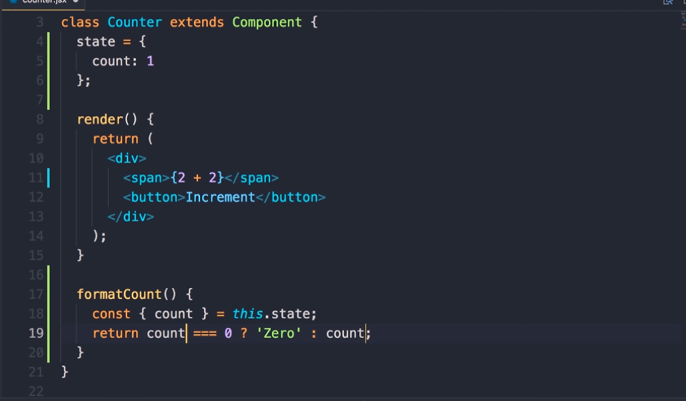

Slide 20
improve this code look we have this repetition of this.state.count
whenever you have code like this that's a perfect opportunity to use object destructuring that you learned about in the last section
so we can destructure this object and pick the count property
Const { count } =this.state
so we're picking the count property of this object and storing it in a separate constant called count
now I'm gonna select this expression press command + D or ctrl + d
so both these expressions are selected now let's change both of them to count that is better save the changes

Slide 21
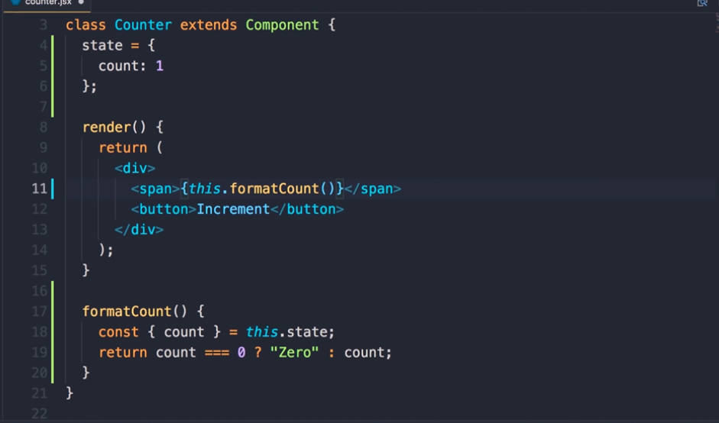

Slide 22
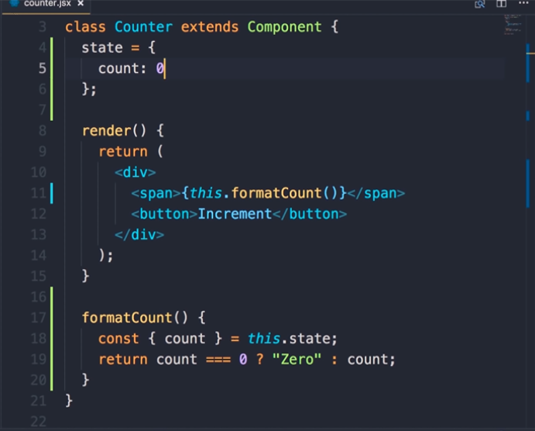

Slide 23
call this.formatCount now save the changes so currently our count is 1 that's why we see 1
change count to 0 save the changes we get the labels 0

Slide 24
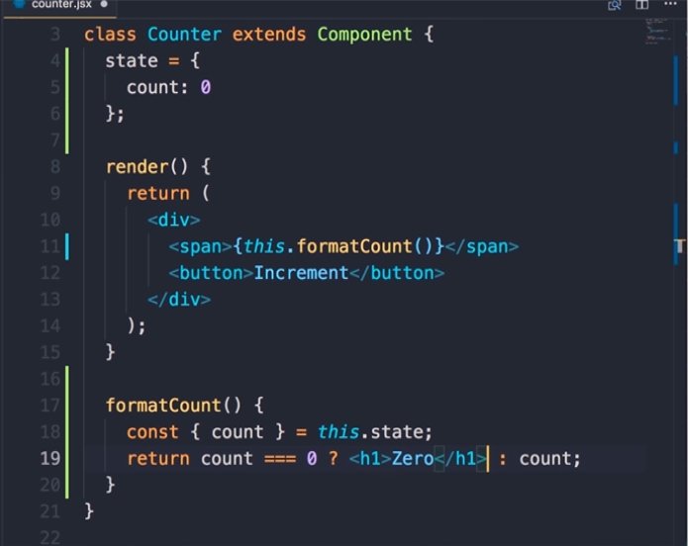

Slide 25
now to take this to the next level we can also return a JSX expression here because as we told you before JSX expressions get compiled to react elements so here instead of returning a plain text we can return h1 with 0 as the inner text so save the changes now we have an h1 here so this is what I want you to understand JSX expressions are just like normal JavaScript objects you can return them from a function you can pass them to a function you can also use them as the knew of a constant or variable so here I can define a constant and set it with JSX expression that's perfectly fine so now

Slide 26
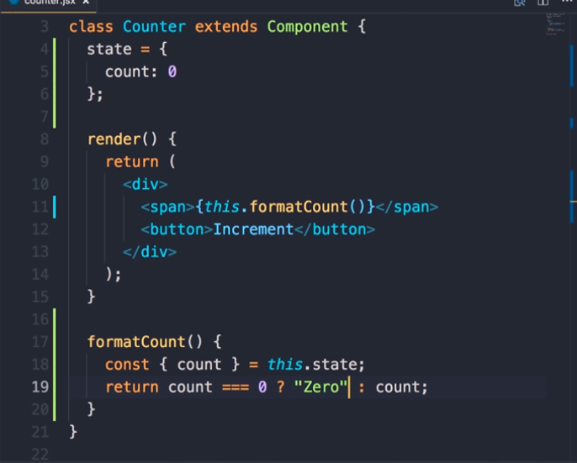

Slide 27
let's simplify this code we don't need this anymore and here on line 19
I return 0 as a plain text

